Slide 1
DBMS LAB

Slide 2
DBMS
Database Management System (DBMS):
It is a software it helps to manage the database .
Should able to perform the following activities very easily.
1. Inserting the new data.
2. Updating the exiting data.
3. Deleting unnecessary data.
4. Retrieving the require data.

Slide 3
DBMS
A database along with the software which helps to manage. The database is called database management system (DBMS).
A DBMS which is based on relational model called relational database management system.
Examples of RDBMS:
1. ORACLE
2. SQL SERVER
3. DB2
4. MYSQL
5. SYBASE
6. TERA DATA
7. MS ACCESS

Slide 4
SQL –STRUCTURED QUERY LANGUAGE
SQL Commands:
The SQL language is subdivided according to their functions as follows
DDL - Data Definition Language
DML - Data Manipulation Language
TCL - Transaction Control Language
DCL – Data Control Language

Slide 5
DATA DEFINITION LANGUAGE (DDL):
Data Definition Language (DDL) or Schema Definition Language, statements are used to define the database structure or schema.
CREATE - to create objects in the database
ALTER - alters the structure of the database
DROP - delete objects from the database
TRUNCATE - remove all records from a table, including all spaces allocated for the records are removed
RENAME - rename an object

Slide 6
DATA MANIPULATION LANGUAGE (DML):
Data Manipulation Language (DML) statements are used for managing data within schema objects.
INSERT - insert data into a table
UPDATE - updates existing data within a table DELETE - deletes all records from a table, the space for the records
SELECT - retrieve data from the a database

Slide 7
DATA CONTROL LANGUAGE (DCL):
Data Control Language (DCL) statements.
GRANT - gives user's access privileges to database
REVOKE - withdraw access privileges given with the GRANT command

Slide 8
TRANSACTION CONTROL (TCL)
Transaction Control (TCL) statements are used to manage the changes made by DML statements.
It allows statements to be grouped together into logical transactions.
COMMIT - save work done
SAVEPOINT - identify a point in a transaction to which you can later roll back
ROLLBACK - restore database to original since the last

Slide 9
RULES
1. Oracle reserved words cannot be used.
2. Underscore, numerals, letters are allowed but not blank space.
3. Maximum length for the table name is 30 characters.
4. Two different tables should not have same name.
5. We should specify a unique column name.
6. We should specify proper data type along with width.
7. We can include “not null” condition when needed. By default it is ‘null’.
8. It is a command based language.
9. It is not case sensitive.
10. Every command should end with ‘;’.

Slide 10
SQL – STRUCTURED QUERY LANGUAGE
SQL Operators
An operator is a reserved word or a character used primarily in an SQL statement's WHERE clause to perform operation(s), such as comparisons and arithmetic operations.
Operators are used to specify conditions in an SQL statement and to serve as conjunctions for multiple conditions in a statement.
Arithmetic operators
Comparison operators
Logical operators Operators (used to negate condition. )

Slide 11
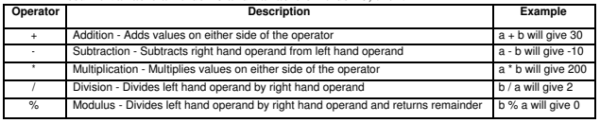
ARITHMETIC OPERATOR

Slide 12
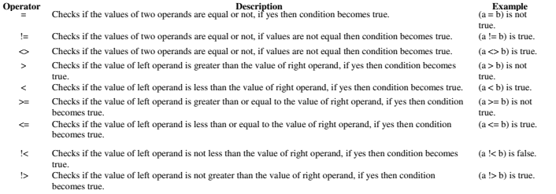
COMPARISON OPERATOR

Slide 13
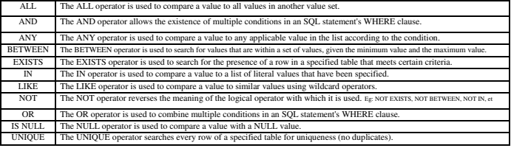
LOGICAL OPERATORS

Slide 14
DATA TYPES
Numeric:
  NUMBER(s,p) – scale and precision
    Ex: number (3)
    number(6,2)
    number(7,3)
  FLOAT(p) -- precision in bits
    Ex: Float(3), float(5), float(7)
Character:
  CHAR(n),
  VARCHAR(n)
Date
  The standard date format for input and output is DD-MON-YY e.g., ‘01-JAN-17’ and within single quotes

Slide 15
TABLE CREATION
Create table
creates a table with given tablename
CREATE TABLE table_name (
column1 datatype,
column2 datatype,
....
);
Ex: CREATE TABLE employee(
empid integer,
empname varchar2(20),
salary float);

Slide 16
PRIMARY KEY
Primary Key – one or more columns (attributes) that uniquely (or distinctly) identifies a tuple (row) in a table.
The following are rules that make a column a primary key:
A primary key column cannot contain a NULL value or an empty string.
A primary key value must be unique within the entire table.
A primary key value should not be changed over time.
Examples:
Student table – primary key is Regno
Customer table – primary key is CustomerId
Employee table – primary key is EmployeeId

Slide 17
COMPOSITE PRIMARY KEY
When a primary key is created from a combination of 2 or more columns, the primary key is called a composite key.
Each column may not be unique by itself within the database table but when combined with the other column(s) in the composite key, the combination is unique.
Example:
  Course table will have
  primary key as (regno, semno, coursecode)
  Orders table will have primary key as (customer id, order no)

Slide 18
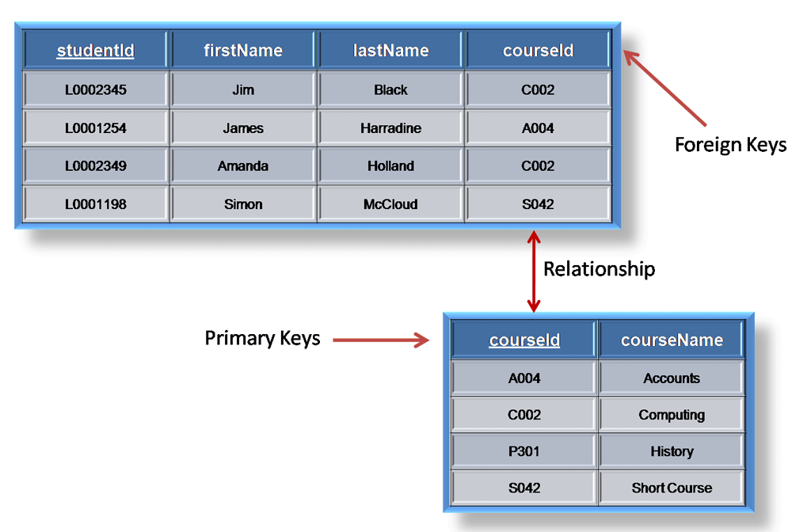
PRIMARY KEY AND FOREIGN KEY
Referencing table
Referenced table
Key in referenced table is primary key
Key in referencing table is foreign key

Slide 19
FOREIGN KEY
A foreign key is all about the relationship between two entities (tables)
concept of referential integrity is all about maintaining and enforcing this parent-child relationship.
CREATE TABLE child_table ( ...
CONSTRAINT fk_name
FOREIGN KEY(col1) REFERENCES parent_table(col1)
);
Examples: Student and courses are related through the column (attribute) Register Number
Customer and Orders are relate through Customer Number

Slide 20
IDENTIFYING PARENT AND CHILD TABLE
Independent table – parent table
Example: Student exists without courses – Hence Stuent is a parent table
Dependent table – Child table
Ex: Courses cannot exist without students (Child table) – Only authorized students can do courses (data integrity)
Customer and Orders?
Students and Exams?
Mobile Plans and Customers?
Parent Table: A table which does not depend for its existence
Child Table: A table which depends for its existence on another table (ensuring data integrity).

Slide 21
DEFINING KEYS –
DURING TABLE CREATION – DO THIS NOW.
Create table Student( regno char(15) primary key, sname char(15), dob date, address varchar(20)) OR
Create table Student( regno char(15), sname char(15), dob date, address varchar(20), primary key (regno))
Insert into student values(‘19101’,’Adit’, ’12-Feb-1999’,’cbe’);
Insert into student values(‘19102’,’Aswath’, ’10-jul-1999’,’cbe’);
Insert into student values(‘19301’,’Subath’, ’22-jun-2000’,’mas’);
Insert into student values(‘19345’,’Raga’, ’14-Sep-2000’,’mas’);
Create table Courses(regno char(15) , semno number(2),
coursecode char(10), marks number(3), grade char(1),
primary key (regno,semno,coursecode),
foreign key(regno ) references Student(regno) );
Insert rows/ records – remember regno+semno+coursecode should not duplicate, and regno should be in student table
Insert 3 rows for each student from student table to courses table;

Slide 22
EXAMPLE 2:
CREATE TABLE purchase_orders (
po_nr NUMBER PRIMARY KEY,
vendor_id NUMBER NOT NULL,
po_status NUMBER(1,0) NOT NULL
);
OR
CREATE TABLE purchase_orders (
po_nr NUMBER,
vendor_id NUMBER NOT NULL,
po_status NUMBER(1,0) NOT NULL,
CONSTRAINT pk_purchase_orders PRIMARY KEY(po_nr)
);

Slide 23
EXAMPLE 2:
CREATE TABLE purchase_order_items (
po_nr NUMBER NOT NULL,
item_nr NUMBER NOT NULL,
product_id NUMBER NOT NULL,
quantity NUMBER NOT NULL,
purchase_unit NUMBER NOT NULL,
buy_price NUMBER (9,2) NOT NULL,
delivery_date DATE,
PRIMARY KEY (po_nr, item_nr)
→ Composite Primary key
);

Slide 24
ALTER TABLE
To add a column:
ALTER TABLE table_name ADD (
column_name_1 data_type constraint,
column_name_2 data_type constraint, ... );
Example:
Alter table student add (email varchar(20) NOT NULL, phone number(12));
ALTER TABLE table_name MODIFY ( column_name_1 action,
column_name_2 action, ... );
Ex: ALTER TABLE student MODIFY sname VARCHAR( 50 );

Slide 25
ALTER TABLE – ADD CONSTRAINTS
Syntax: ALTER TABLE table_name ADD CONSTRAINT constraint_name constraint_definition;
Add Primary Key
Add Foreign Key
Add Check constraint

Slide 26
DEFINING KEYS – AFTER TABLE CREATION
Syntax: ALTER TABLE table_name ADD CONSTRAINT constraint_name PRIMARY KEY (column1, column2, ...);
Examples:
Alter table student add primary key (regno);
Alter table courses add constraint courses_pkey primary key(regno,semno,coursecode);
Alter table courses add constraint courses_fkey foreign key(regno) references student(regno);
constraint – Keyword to add a constraint
courses_pkey, courses_fkey → name of constraint

Slide 27
EXAMPLE 3:
CREATE TABLE vendors (
vendor_id NUMBER,
vendor_name VARCHAR2(255) NOT NULL,
address VARCHAR2(255) NOT NULL
);
ALTER TABLE vendors
ADD CONSTRAINT pk_vendors PRIMARY KEY (vendor_id);
Insert into vendors(100, ‘TCS’, ‘Chennai’);
Insert into vendors(101, ‘Wipro’, ‘Coimbatore’);
Insert into vendors(1, ‘Microsoft’, ‘Redmond’);
Select * from vendors; (lists all rows inserted)

Slide 28
EXAMPLE 4:
CREATE TABLE supplier_groups(
group_id NUMBER,
group_name VARCHAR2(255) NOT NULL,
PRIMARY KEY (group_id)
);
CREATE TABLE suppliers (
supplier_id NUMBER,
supplier_name VARCHAR2(255) NOT NULL,
group_id NUMBER NOT NULL,
PRIMARY KEY(supplier_id),
FOREIGN KEY(group_id) REFERENCES supplier_groups(group_id)
);

Slide 29
CHECKING HOW KEYS WORK
INSERT INTO supplier_groups VALUES(100, 'One-time Supplier');
INSERT INTO supplier_groups VALUES(10, 'Third-party Supplier');
INSERT INTO supplier_groups VALUES( 15, 'Inter-co Supplier');
INSERT INTO suplier_groups VALUES(15, ‘Own supplier’);
ORA-00001: unique constraint (…..) violated -- means « primary key violation – groupid 15 already exists »
Check: SELECT * FROM supplier_groups;
INSERT INTO suppliers VALUES(1000, 'Toshiba',10);
INSERT INTO suppliers VALUES(1010, ‘HP',15);
INSERT INTO suppliers VALUES(2000, 'WD',4);
SQL Error: ORA-02291: integrity constraint (OT.SYS_C0010646) violated - parent key not found
Error as group id 4 not in supplier groups table;

Slide 30
CHECK CONSTRAINT
Check constraint allows you to enforce domain integrity by limiting the values accepted by one or more columns.
To create a check constraint, you define a logical expression that returns true or false.
Example: Age of a student to be < 21, salary > 0,
Oracle uses this expression to validate the data that is being inserted or updated.
If the expression evaluates to true, Oracle accepts the data and carry the insert or update.
Otherwise, Oracle will reject the data and does not insert or update at all.

Slide 31
EXAMPLES:
Syntax: CONSTRAINT check_constraint_name CHECK (expression);
Example:
Alter TABLE student add age number(3);
→ adds a column to table student
ALTER TABLE student add CONSTRAINT check_age check (age <25);
How to check?
Insert into student values(‘19400’,’Nada’, ’24-Sep-2000’,’Tpy’, 29);
ORA-02290: check constraint (…) violated -- means value is wrong

Slide 32
DROP TABLE
DROP TABLE
Drops the existing table
DROP TABLE table_name;
Eg: DROP TABLE employee;
Table Description
Decribes the schema of the table
DESC table_name;
Eg: DESC employee;

Slide 33
TRUNCATE TABLE
TRUNCATE TABLE :
Used to delete the all records in a table, but not the table itself.
Does not delete table
TRUNCATE TABLE table_name;
Eg: TRUNCATE TABLE employee;

Slide 34
DML .. INSERT
INSERT: Used to populate the table
Syntax:
INSERT INTO table_name VALUES (value_list);
OR
INSERT INTO table_name (column_list) VALUES( value_list);
all Char/varchar data type values to be entered within ‘single quotes’
All date to be entered as ‘dd-mon-yy’ in single quotes
Ex: insert into student values('320','abc','12-jan-1990','cbe',22);

Slide 35
DML … UPDATE
Syntax: UPDATE table_name SET column1 = value1,
column2 = value2, column3 = value3, ...
WHERE condition;
Examples:
Update student set age = age+1;
Update courses set marks=marks+5, grade='A';

Slide 36
DELETE
Syntax:
DELETE FROM table_name WHERE condition;
Ex: DELETE FROM student
→ deletes all rows (tuples/ records) from student
DELETE FROM student where regno=‘100’
deletes all rows (tuples/ records) from student with regno as 100;

Slide 37
Transaction Control Statements
Transaction:
  Set of statements from last DCL to present
  Ex: all commands (statements) such as insert, update, delete from last create/alter/drop
  Not applicable for DCL
Commit
  Confirm changes done to the database (all tables)
Rollback
  Revert or Undo the transaction to previous state of the database
  Cannot revert after commit

Slide 38
TCL – Examples
Consider the following statements:
  Insert into student values(‘210’, ‘Aswin’ ,’13-Nov-1999’, ‘Mas’, 20);
  Update courses set marks = marks *0.10;
  Delete from student;
What happens if we give rollback now?
  All three statements will be reverted
What happens if we give commit now?
  All three statements will be done and cannot issue rollback
All these statements form one transaction

Slide 39
What is a Transaction ?
Starts after a DCL, ends with a DCL
  Ex: after create/alter/drop
  All insert/update/delete
  Upto next create/alter/drop
  Auto commit, cannot rollback
Starts after a DCL, ends with commit/rollback
Starts after TCL, ends with TCL
Starts after TCL, ends with TCL

Slide 40
QUERIES ON SINGLE RELATION
BASIC “SELECT” QUERIES

Slide 41
Create table Student( regno char(15), sname char(15), dob date, address varchar(20), age number(3) primary key (regno))
Regno | SName | Dob | Address | Age
19101 | Adit | 12-jan-1999 | Cbe | 20
19102 | Aswath | 1o-jul-2000 | Mas | 18
19301 | Subath | 22-jun-2000 | Mas | 17
19345 | Raga | 14-sep-2000 | Mas | 17
19400 | Mona | 15-oct-2000 | Cbe | 18
19500 | Mina | 10-dec-2000 | Mas | 19
19600 | Mino | 10-sep-2000 | Mas | 19
19221 | Riga | 11-jan-2000 | Mas | 19
19200 | Adib | 12-mar-1999 | cbe | 20

Slide 42
Create table Courses(regno char(15) , semno number(2), coursecode char(10), marks number(3), grade char(1), primary key (regno,semno,coursecode), foreign key(regno ) references Student(regno) );
Regno | Semno | Coursecode | Marks | Grade
19101 | 1 | Cs101 | 78 | B
19101 | 1 | Cs100 | 88 | A
19101 | 2 | Ma101 | 90 | B
19102 | 2 | Cs101 | 79 | B
19102 | 1 | Cs103 | 89 | A
19102 | 2 | Cs100 | 90 | A
19221 | 2 | Cs100 | 88 | B
19221 | 1 | Ma101 | 99 | O
19221 | 2 | Cs103 | 88 | B
19200 | 2 | Cs104 | 90 | A
19200 | 1 | Cs100 | 90 | A
19200 | 1 | Cs101 | 99 | O

Slide 43
Basic Query Structure
The SQL data-manipulation language (DML) provides the ability to query information, and insert, delete and update tuples
A typical SQL query has the form:
SELECT column_1, column_2, ... FROM table_name;
First, specify the table name from which you want to query the data.
Second, indicate the columns from which you want to return the data. If you have more than one column, you need to separate each by a comma (,).
The result of an SQL query is a relation.
Notes:
2

Slide 44
The select Clause
The SELECT statement is used to select data from a database
Example: find the names of all student:
select sname from student
NOTE: SQL names are case insensitive (i.e., you may use upper- or lower-case letters.)
  E.g. Name ≡ NAME ≡ name
Notes:
3

Slide 45
The select Clause (Cont.)
An asterisk in the select clause denotes “all attributes”
select * from student
The select clause can contain arithmetic expressions involving the operation, +, –, ∗, and /, and operating on constants or attributes of tuples.
The query:
select regno, name, age+2 from student
would return a relation that is the same as the student relation, except that the value of the attribute age added by 2.
Notes:
5

Slide 46
The where Clause
The where clause specifies conditions that the result must satisfy
Comparison results can be combined using the logical connectives
and, or, and not.
Comparisons can be applied to results of arithmetic expressions.
To find all students from Cbe with age < 19
select sname
from student
where address = ‘Cbe’; and age < 19;
Notes:
6

Slide 47
Operators in WHERE Clause
Operator | Description
= | Equal
<> | Not equal. Note: In some versions of SQL this operator may be written as !=
> | Greater than
< | Less than
>= | Greater than or equal
<= | Less than or equal
BETWEEN | Between an inclusive range
LIKE | Search for a pattern
IN | To specify multiple possible values for a column

Slide 48
Do the following queries on student table
Display the details of all students who come from Cbe.
  Select * from student where address=‘Cbe’:
Display the details of all students whose age ranges between 17 and 19
  Select * from student where age between 17 and 19;
    Both inclusive
Display the details of ‘Adit’ and ‘Raga’
  Select * from student where sname=‘Adit’ or sname=‘Raga’;
  Select * from student where name in (‘Adit’, ‘Raga’);

Slide 49
More queries to learn …
select * from student
where name in (‘Mina’, ‘Mino’);
select * from student
where name not in (‘Mina’, ‘Mino’);
select * from student
where age between 19 and 20;
select * from student
where age not between 19 and 20;
select * from student
where not age=22;

Slide 50
LIKE Operator
LIKE Operator | Description
WHERE sname LIKE 'a%' | Finds any values that start with "a"
WHERE sname LIKE '%a' | Finds any values that end with "a"
WHERE sname LIKE '% d %' | Finds any values that have "or" in any position
WHERE sname LIKE '_r%' | Finds any values that have "r" in the second position
WHERE sname LIKE 'a_%_%' | Finds any values that start with "a" and are at least 3 characters in length
WHERE sname LIKE 'a%t' | Finds any values that start with "a" and ends with "o"

Slide 51
ORDER BY Syntax
The ORDER BY clause orders or sorts the result of a query according to the values in one or more specific columns.
SELECT column1, column2, ...
FROM table_name
ORDER BY column1, column2, ... ASC|DESC;

Slide 52
Order By Examples
Display the details of courses as the ascending order of marks
  Select * from courses order by marks;
Display all details of courses in descending order of grades
  Select * from courses order by grade desc;
  Select * from courses order by grade, marks;
  Select * from courses order by grade desc, marks;
  Select regno, coursecode,grade from courses order by 2 desc, 1 asc;
    Positional sorting of data

Slide 53
Aggregate Functions
These functions operate on the multiset of values of a column of a relation, and return a value
avg: average value (mean)
min: minimum value
max: maximum value
sum: sum of values
count: number of values

Slide 54
Aggregate Functions
Find the average marks stored by students in the course ‘Cs100’
  select avg (marks) from courses where coursecode=‘Cs100’;
Find the number of tuples in the courses relation
  select count (*) from courses;
How many students are in the class?
  Select count(*) from student;
How many students have scored ‘A’ grade ?
  Select count(*) from courses where grade=‘A’;
How many courses has ‘19101’ registered?
  Select count(*) from courses where regno='100';
What is the total marks scored by all students in CS100?
  Select sum(marks) from courses where coursecode=‘Cs100’;

Slide 55
Aggregate functions
What is the minimum, maximum and average marks scored in all courses?
  Select min(marks),max(marks),avg(marks) from courses;
What is the minimum, maximum and average marks scored in Cs100
  Select min(marks),max(marks),avg(marks) from courses where coursecode=‘Cs100’;

Slide 56
Join Query – Relating one or more tables
Join is used to combine columns from two or more tables based on values of the related columns. The related columns are typically the primary key column(s) of the first table and foreign key column(s) of the second table.
Syntax: Select
table1.column1,
table1.column2,
table2.column1, …
From table1, table2
Where
table1.primarykey = table2.foreignkey

Slide 57
Examples of Join
Display register number, student names, coursecode, grade of all students
  Select student.regno, student.sname, courses.coursecode, courses.grade
  from student, courses (→ note 2 tables )
  where student.regno=courses.regno;
  → JOIN – relating the tables using keys
Student table primary key is regno
Courses foreign key is regno -- refer key creation

Slide 58
More join queries
Display register number, student names, coursecode, grade who have taken courses in semester 1.
  Select student.regno, student.sname, courses.coursecode, courses.grade
  from student, courses (→ note 2 tables )
  where student.regno=courses.regno
  and semno=1;
  → JOIN – relating the tables using keys

Slide 59
More examples on Join
CREATE TABLE projects(
project_id number(2) PRIMARY KEY,
project_name VARCHAR2(100) NOT NULL
);
-- Insert all activities (projects) given in the class
CREATE TABLE members(
member_id number(5) PRIMARY KEY,
member_name VARCHAR2(100) NOT NULL,
project_id INT,
FOREIGN KEY (project_id) REFERENCES projects(project_id)
);
-- insert all group details doing the activities (projects)

Slide 60
Join query example
List all member names and project names
SELECT member_name, project_name
FROM members m, projects p
(→ note alias names m for members, p for projects, valid only for this query)
Where p.project_id = m.project_id
(→ join using alias names)
ORDER BY member_name;

Slide 61
To join more than 2 tables …
Create table evaluation (pid number(2),
  mid number(5),
  edate date,
  score number(2,1),
  Primary key (pid,mid),
  foreign key(pid) references projects(project_id), foreign key(mid) references members(member_id)
);
-- insert suitable values (atleast 10 records).

Slide 62
Join with more than 2 tables …
List all project names, member names and scores by each one of them.
  SELECT project_name,member_name,score
FROM members m, projects p, evaluation e
(→ note alias names m for members, p for projects, e for evaluation valid only for this query)
Where p.project_id = m.project_id and e.pid=p.project_id and e.mid = m.member_id
(→ join using alias names)

Slide 63
GROUP BY clause – need
Why we need a group by query?
List the average marks in course CS101 from courses
  select avg(marks) from courses where coursecode='cs101';
List the average marks in course MA101 from courses
  select avg(marks) from courses where coursecode=‘ma101';
How do I list all courses along with average marks?
One single query to group a set a values and use aggregate functions to get results.
Need for group by clause.

Slide 64
Group By Clause
Grouping of one or more columns by which you group using the GROUP BY clause. A grouping set is denoted by a list of comma-separated columns in parentheses:
SELECT column_name(s) FROM table_name WHERE condition
GROUP BY column_name(s)
Ex: select coursecode, avg(marks) from courses group by coursecode;
  Lists all courses with average marks.
select coursecode, avg(marks),max(marks),min(marks) from courses group by coursecode;
  Lists all courses with average, max and min marks
  Note that columns listed in select clause to be same as columns in group by clause.

Slide 65
More examples
From Student table, list count of students based on address
  Select address, count(address) from student group by address;
From Members table, list count of members in each project.
  Select project_id, count(*) from members group by project_id;

Slide 66
Group By and Order By
From Student table, list count of students based on address sorted by address
  Select address, count(address) from student group by address order by address;
From Members table, list count of members in each project sorted by project_id
  Select project_id, count(*) from members group by project_id order by project_id;

Slide 67
MORE ON SQL WILL BE IN FURTHER DETAILED COURSE ON DBMS
End of DBMS Module in CSE101

